Slide 1
Load & Stress Tests

Slide 2
The Problem
The system can work perfectly with 1, 2 ,3 users, the system might return an expected output to the user, pass all test.
But does it stand a multiple users? How many? What happens if we’ve being attacked? Or just a big buzz happens and an unexpected number of users using on same time?
Can you think what happened when the corona started? How did Zoom handled such a huge loads? What about Shufersal Online ( it didn’t ☺)

Slide 3
Define! Load Test
Help you understand how does your system behaves under an expected load.
Makes sure your system stands the user expectations.
The Goal of this tests is to ensure an acceptable overall usage experience.
Tests are measured by performance

Slide 4
Define! Stress test
Help you understand what upper limit of the system’s capacity. Testing by using bigger load than expected maximum
We can say stress test help you understand how your system behaves in an extreme cases such as attacks, extreme use for some reason, and more.
The goal of this test is to find your bottles necks.
Tests are measured by robustness and stability

Slide 5
Why not unit test?
In unit test we check the correctness while Load tests and Stress test verifies and system security, determine the system capability ex.

Slide 6
tools

Slide 7
How to choose?
There are a big verity of tools to test those kind of tests.
Some of those test by using a huge number of requests to the application and by doing so creating a big load/stress
Others takes a lot of the server’s computer RAM and Memory. By doing so- it decreases the system resources and creates a load/stress.
We would choose a tool by what is more relevant to our system.

Slide 8
Jmeter

Slide 9
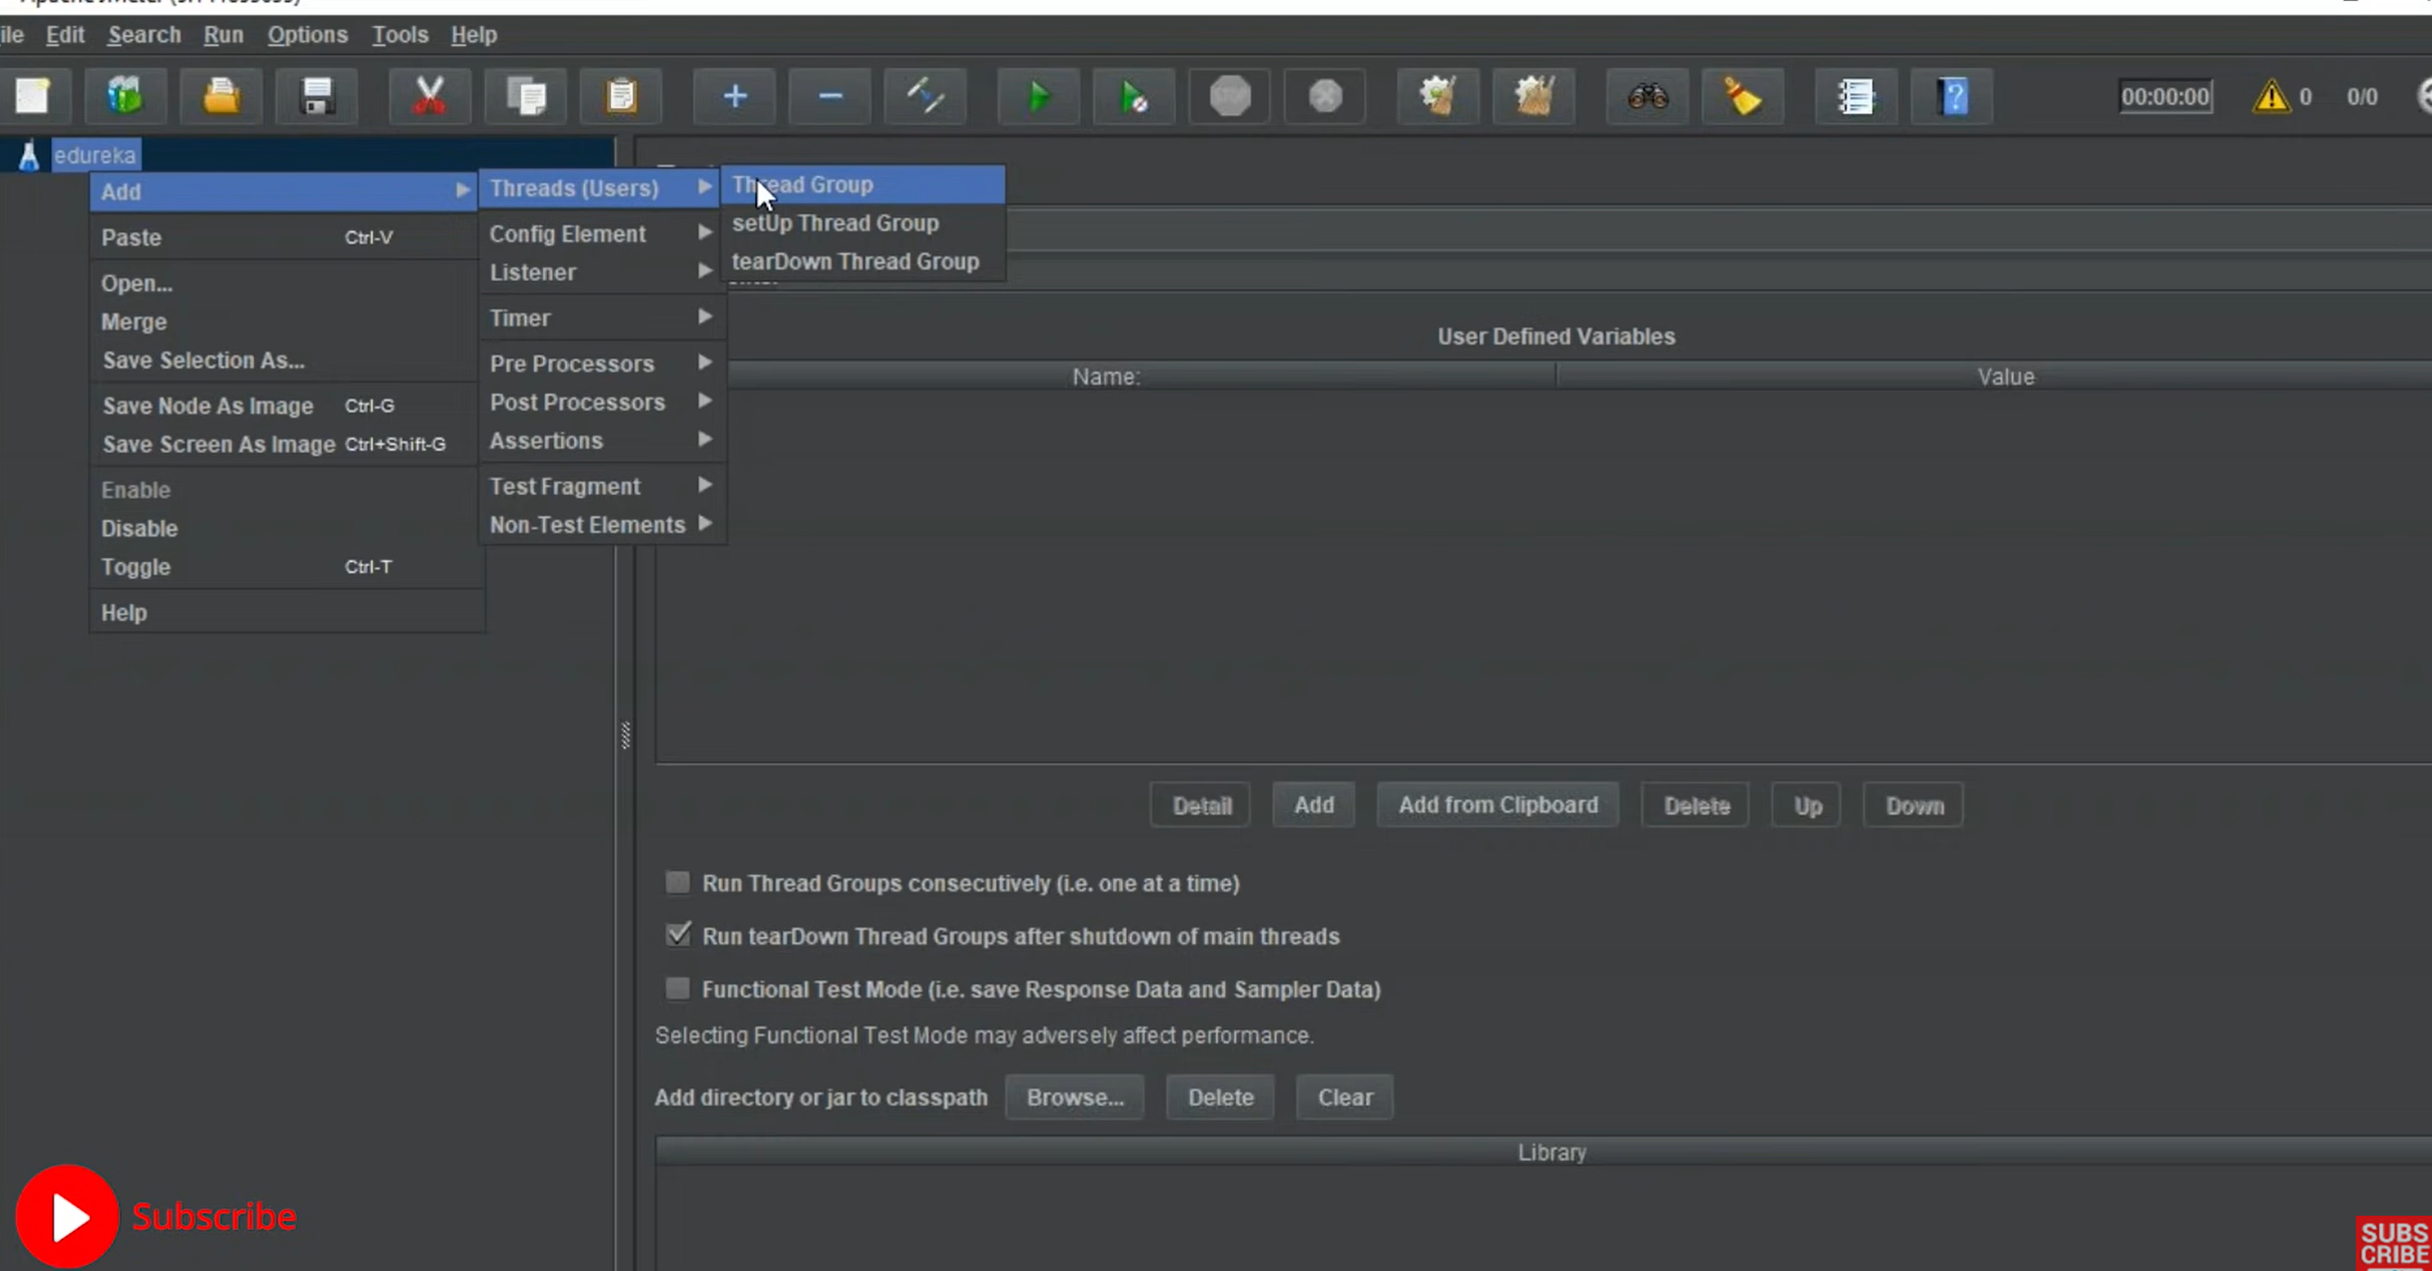
Define thread group

Slide 10
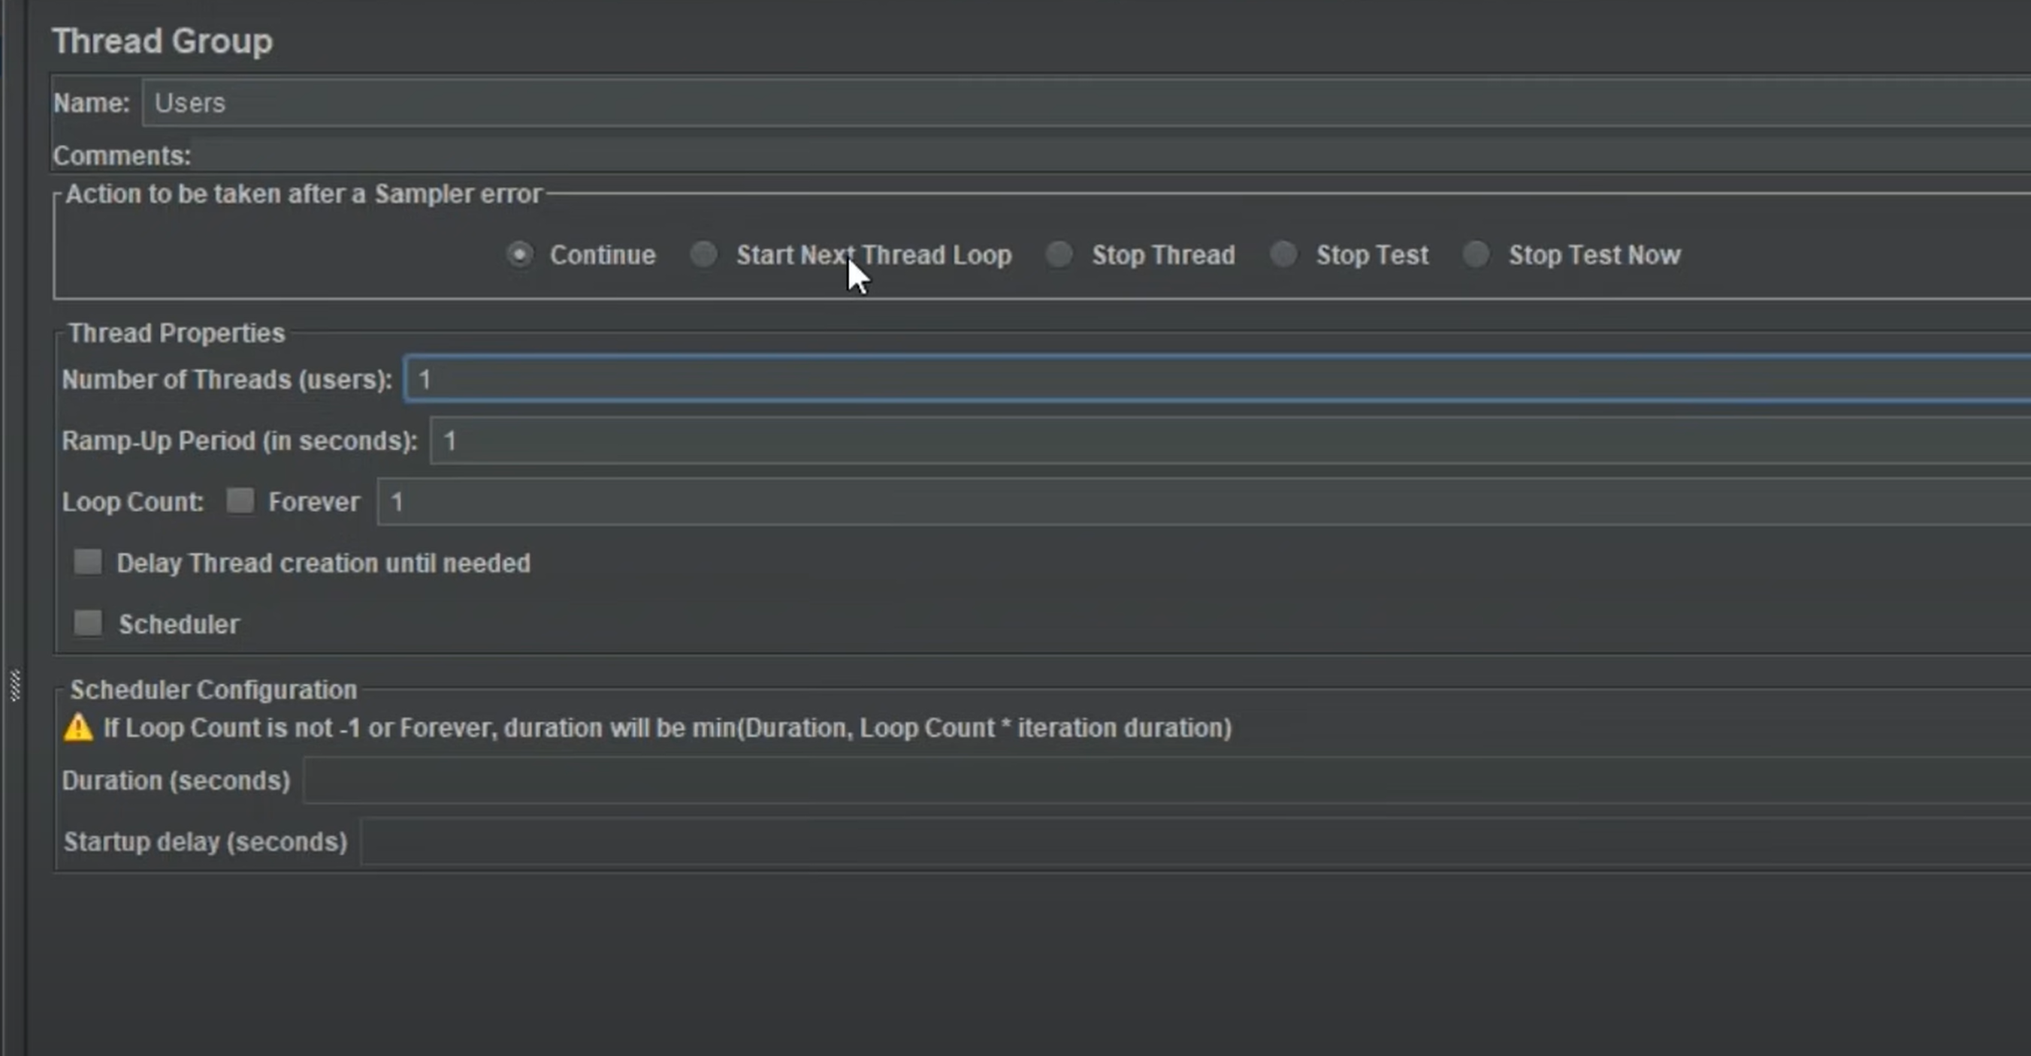
Defines what happens when sampler fails
Thread count and loops

Slide 11
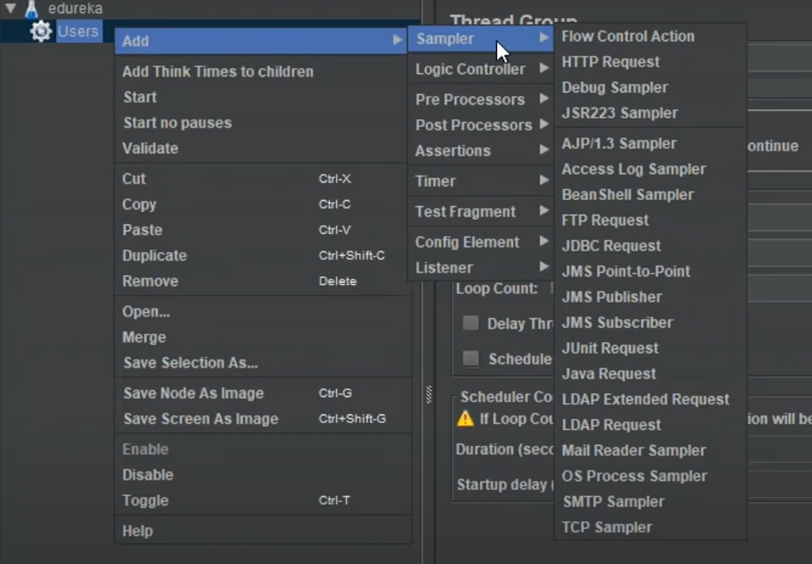
Samplers and listeners

Slide 12
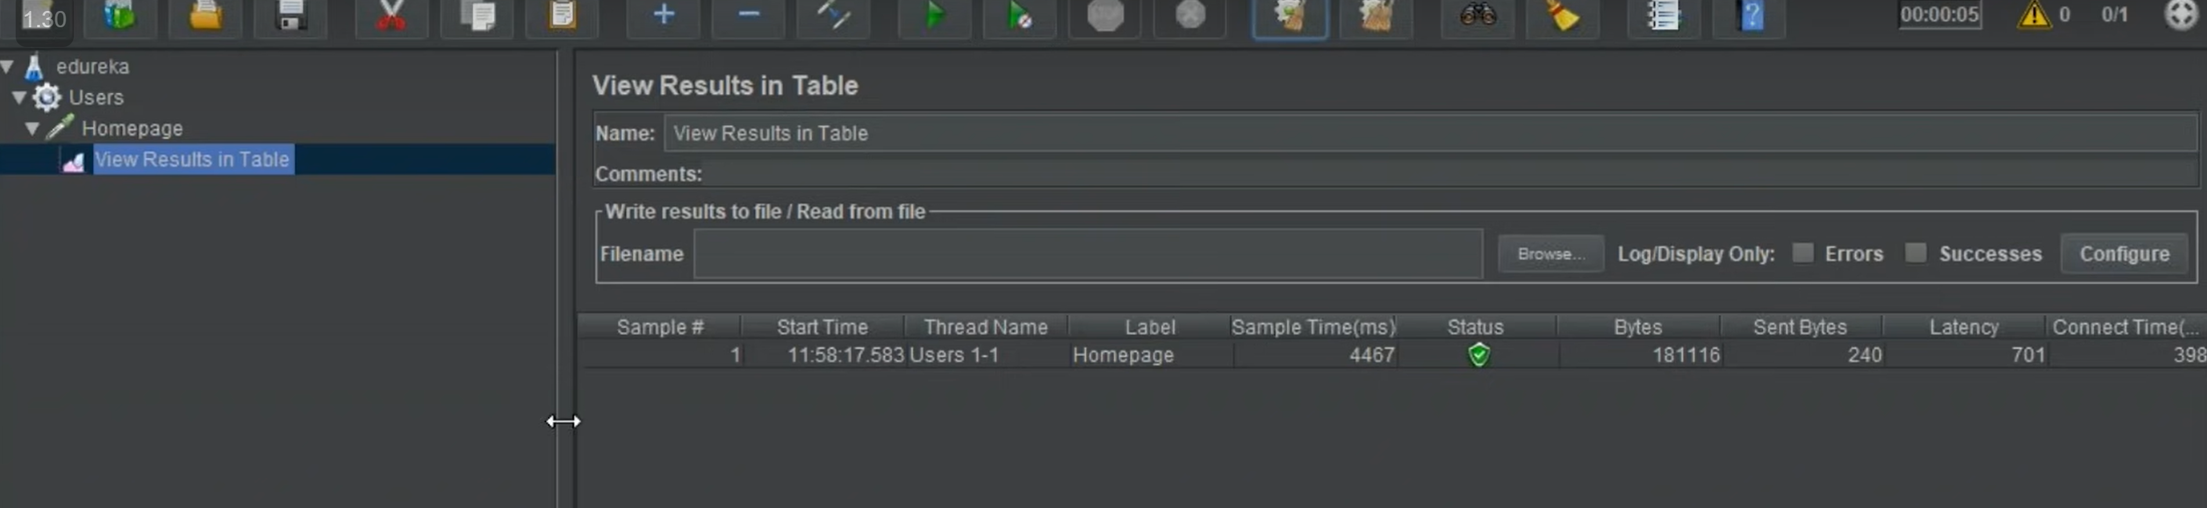
Now when all is done and settled we click Run button and we will get a result in the listener window (created when choosed)

Slide 13
Find bottle necks
Functions that increase error rate
Functions that has big latency

Slide 14
Examples
Register many users
Buy shopping cart for many users
Create items and buy those items buy many users.
Login and log out continuously.
Add item, remove and set

